Slide 1


Atliq Hardwares ad-Hoc Insights

Slide 2
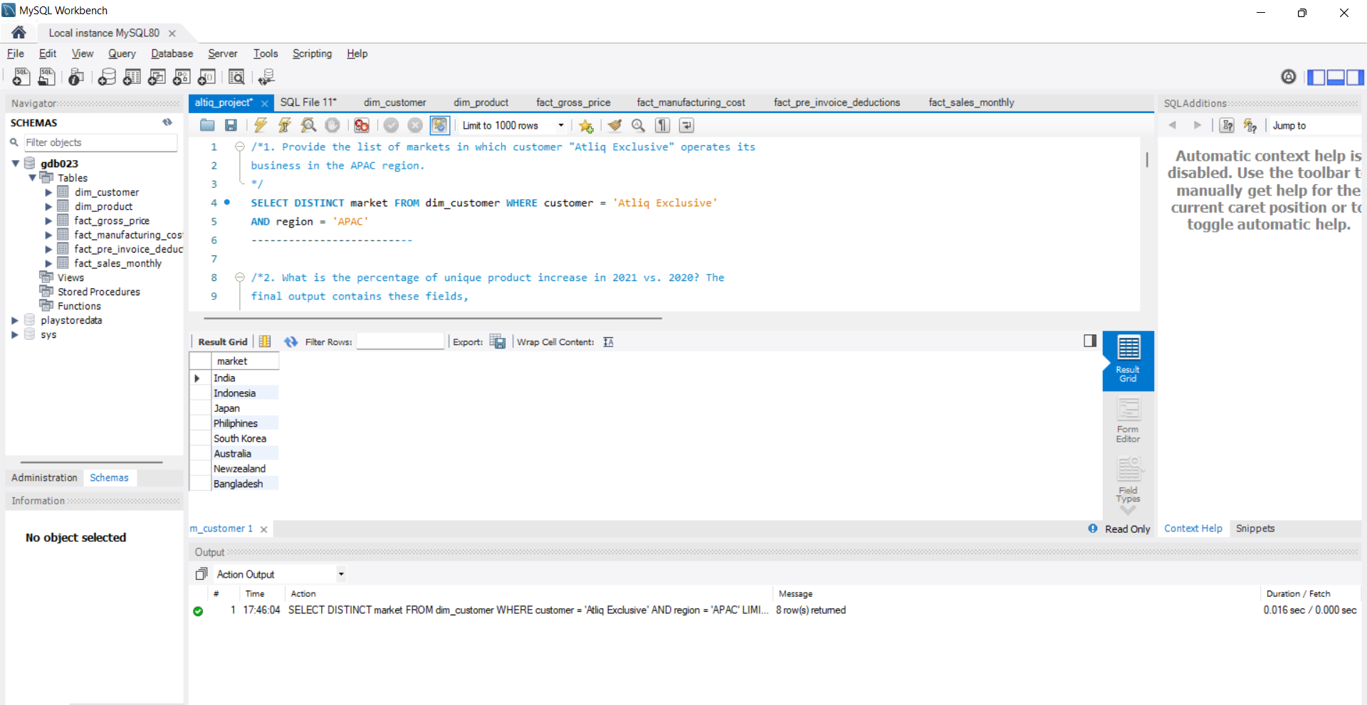
APAC Region markets
Question 1
Provide the list of markets in which customer "Atliq Exclusive" operates its business in the APAC region.
Output:

Slide 3
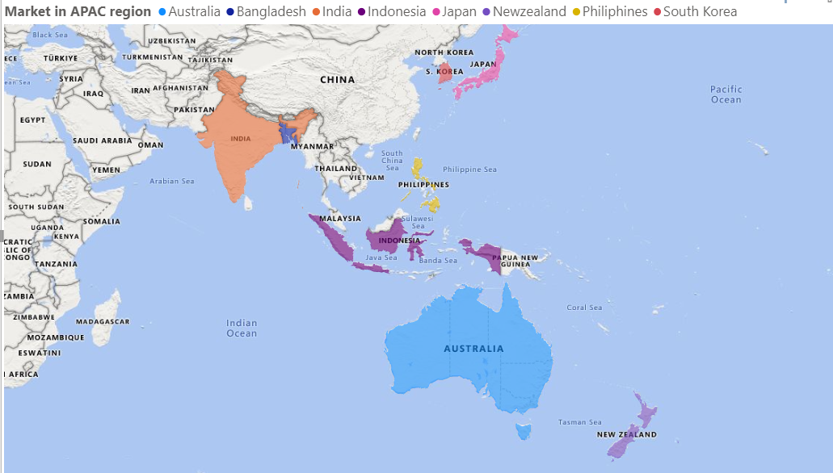
Conversion of output to visual
Insights
1. The markets in the APAC region for “Atliq Harwares” includes India, Indonesia, Japan, Philippines, South Korea, Australia, New Zealand and Bangladesh.

Slide 4
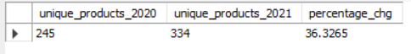
Product Growth analysis
Question 2
What is the percentage of unique product increase in 2021 vs. 2020?
Output:

Slide 5
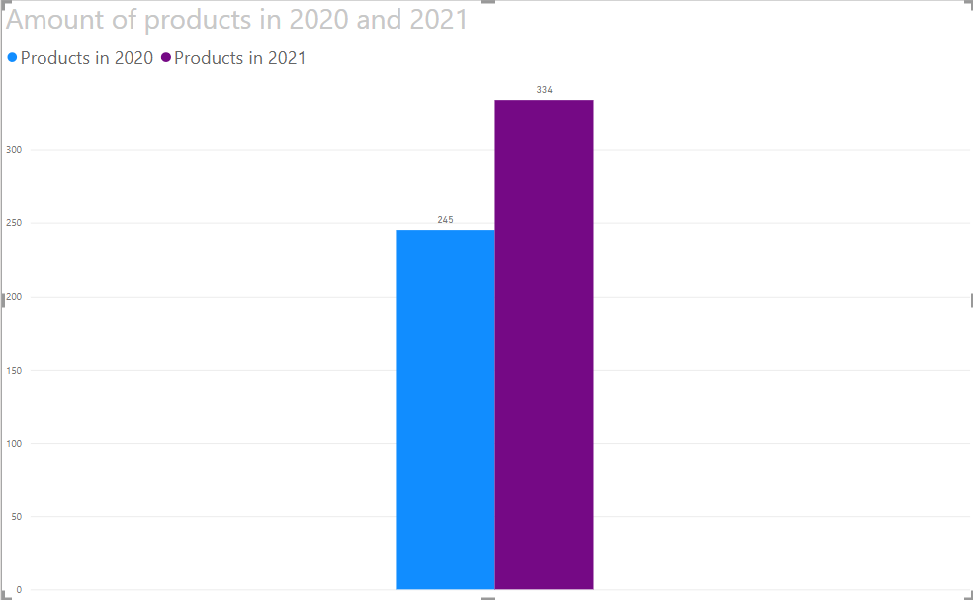
Conversion of output to visual
Insights
Results indicate that “Atliq Hardwares” have increased their revenue by increasing in demand products in the market during 2020 and 2021.
A hopping 36% increase indicate that “Atliq Hardwares” have been competitive with their new products.

Slide 6
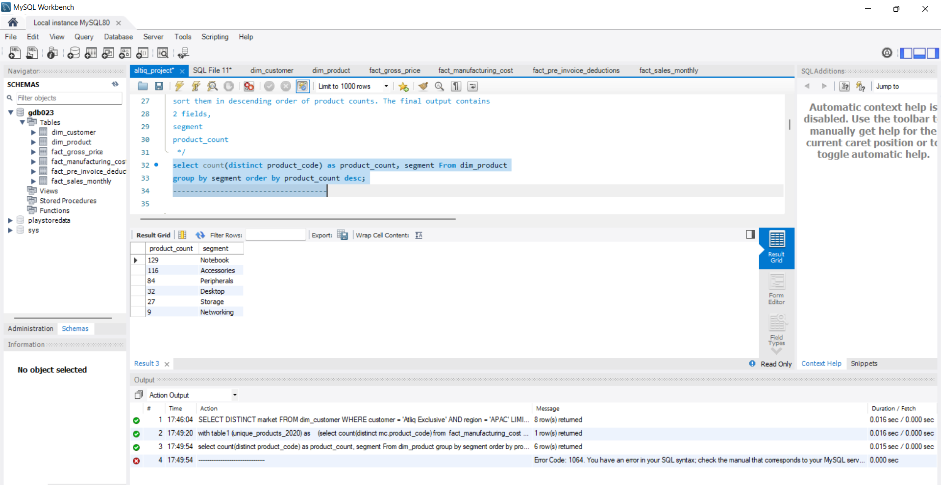
Product analysis by segment
Question 3
Provide a report with all the unique product counts for each segment and sort them in descending order of product counts. The final output contains 2 fields,
segment
product_count
Output:

Slide 7
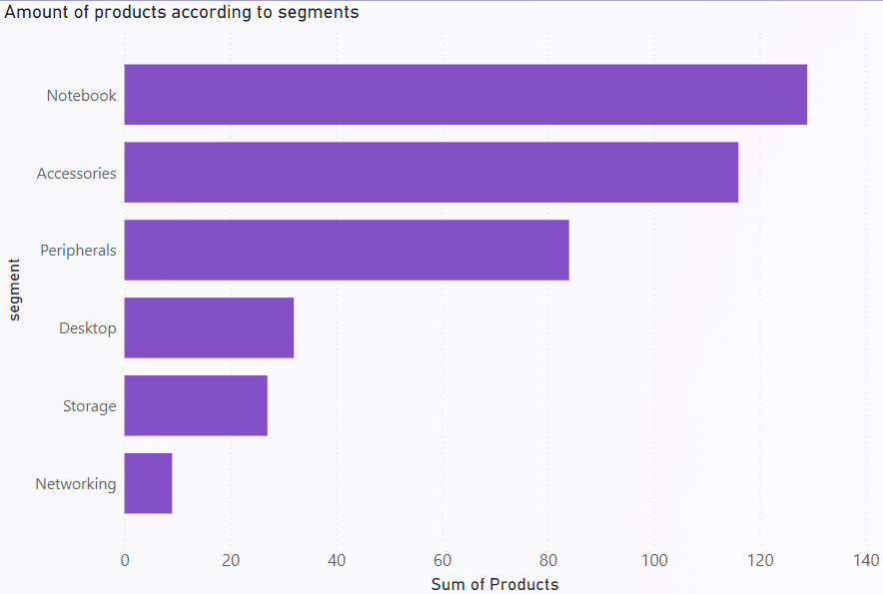
Conversion of output to visual
Insights
Notebook segment has the highest amount of products followed by Accessories, Peripherals, Deskstop, Storage and Networking.
There is a great variety of products which is responsible for the good customer experience.

Slide 8
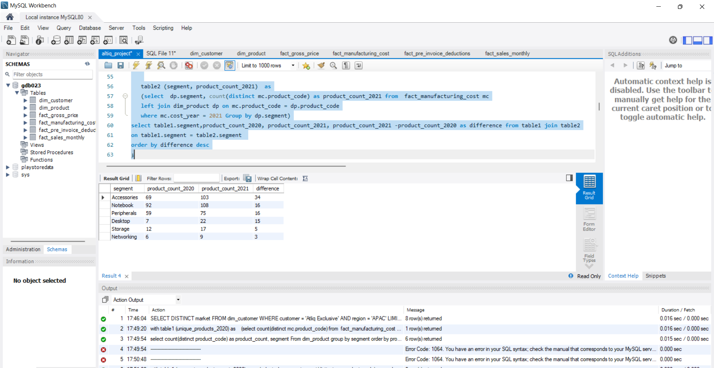
Product Growth analysis by segment
Question 4
Follow-up: Which segment had the most increase in unique products in 2021 vs 2020? The final output contains these fields,
segment
product_count_2020
product_count_2021
difference
Output:

Slide 9
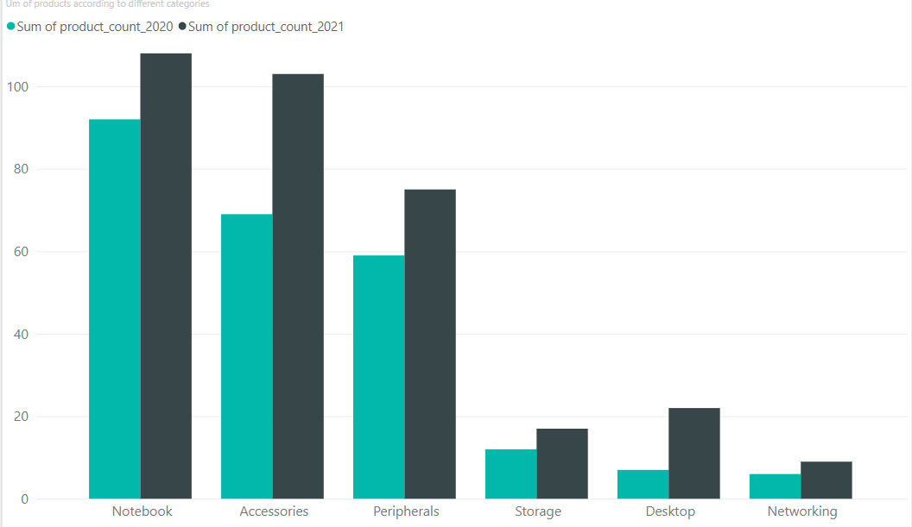
Conversion of output to visual
Insights
Each segment has grown significantly in 2021 indicating high demand in every segment.
The company is utilizing resources to increase products to cater high in demand and to be in competition in the market.

Slide 10
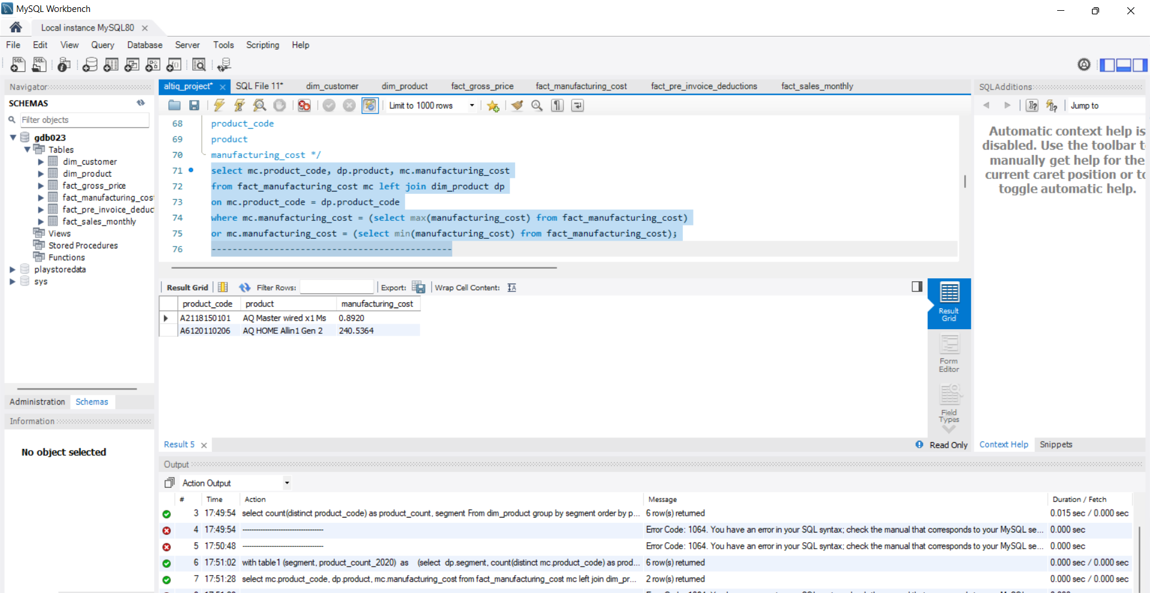
Manufacturing cost range analysis
Question 5
Get the products that have the highest and lowest manufacturing costs. The final output should contain these fields,
product_code
product
manufacturing_cost
Output:

Slide 11
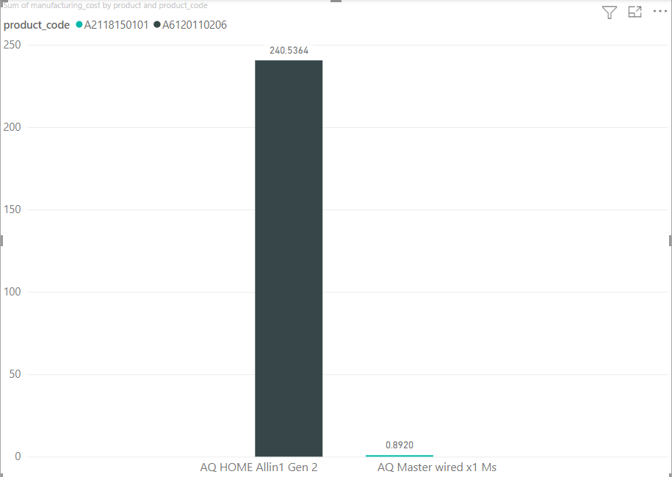
Conversion of output to visual
Insights
“Atliq Hardwares” manufacturing cost has a high range of indicating variety of products catering to all kind of customers.
“Atliq Hardwares” have products which gives good profit margin due to variety of products in every price range.

Slide 12
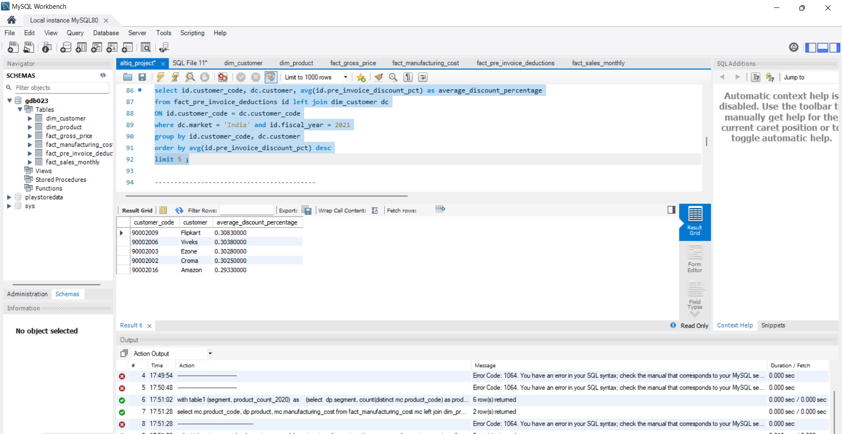
Discount analysis by customer
Question 6
Generate a report which contains the top 5 customers who received an average high pre_invoice_discount_pct for the fiscal year 2021 and in the Indian market. The final output contains these fields,
customer_code
customer
average_discount_percentage
Output:

Slide 13
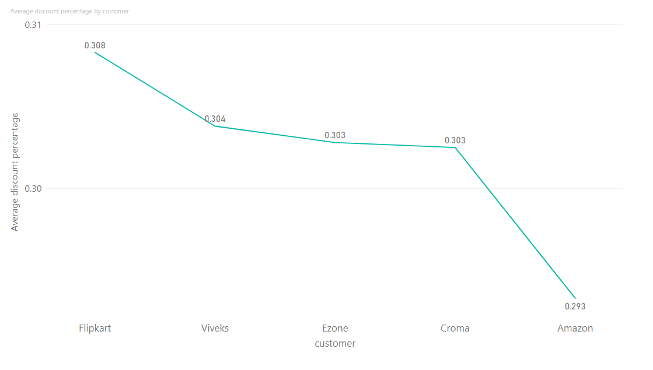
Conversion of output to visual
Insights
The top 5 customers to get highest average discount are Flipkart followed by Viveks, Ezone, Croma and Amazon.
The discount varies in a small range which is good for the company as well as fair to customers.

Slide 14
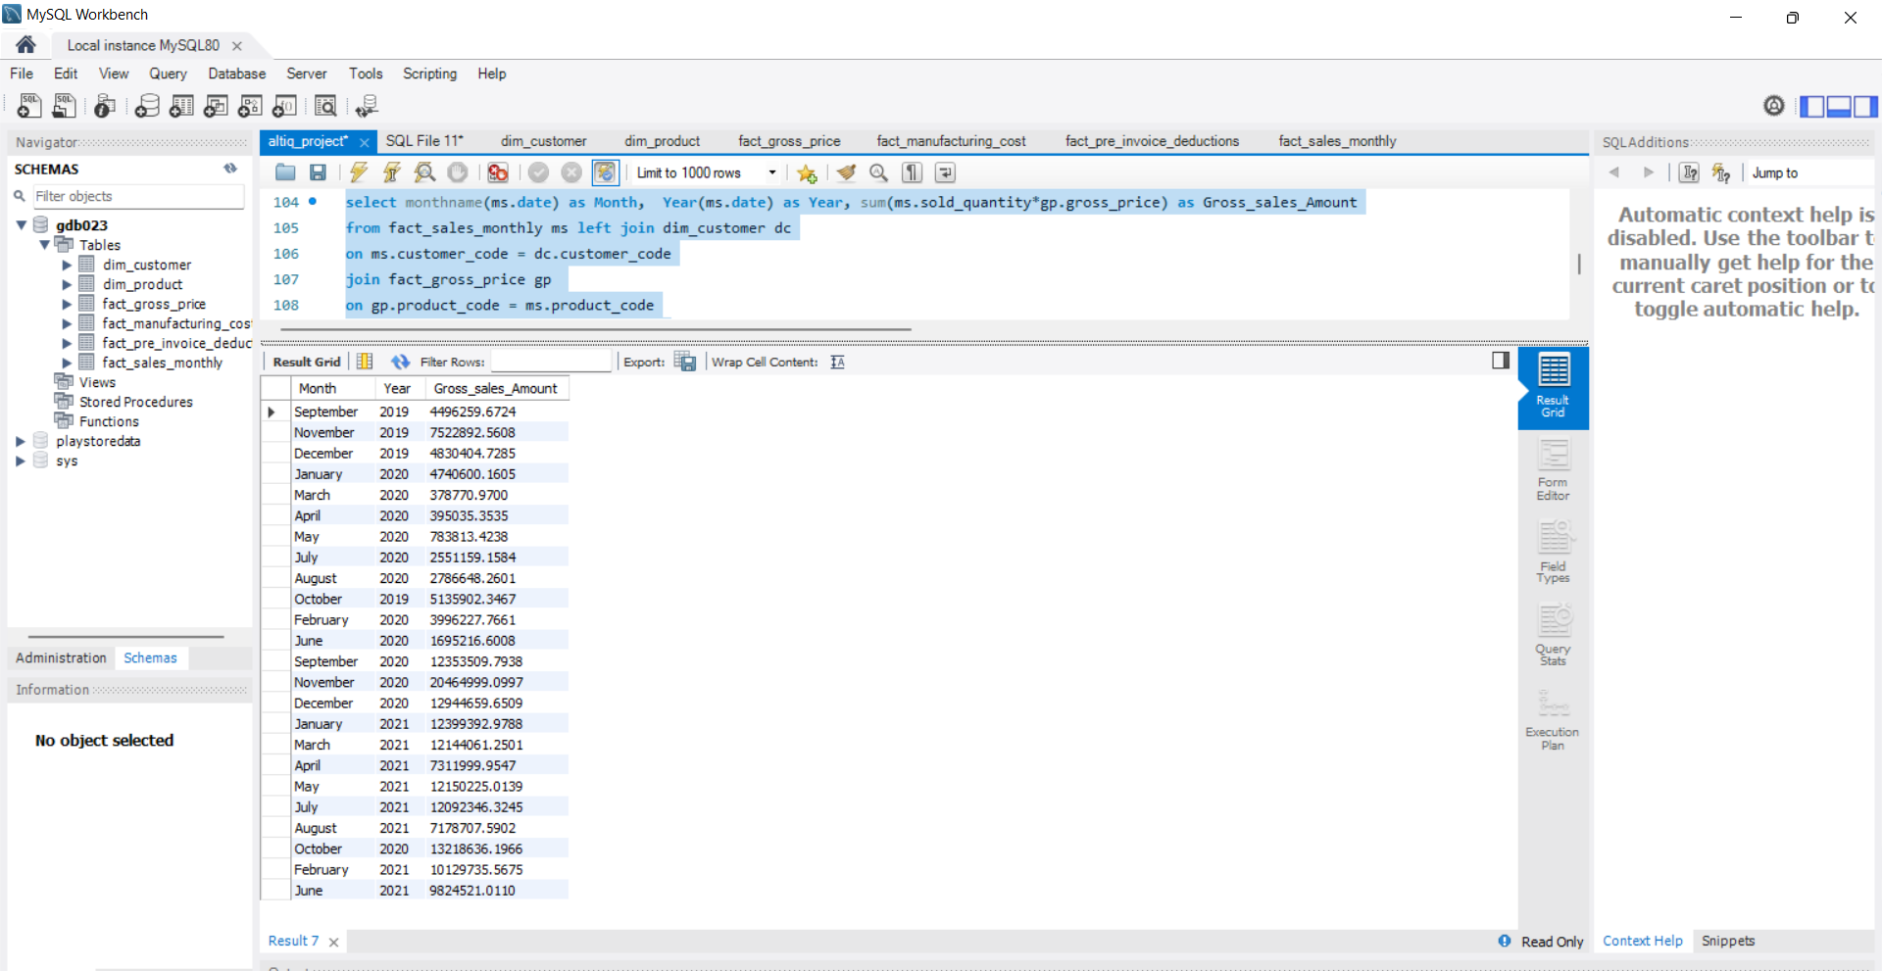
Highest grossing Months Analysis
Question 7
Get the complete report of the Gross sales amount for the customer “Atliq Exclusive” for each month. This analysis helps to get an idea of low and high-performing months and take strategic decisions.
The final report contains these columns:
Month
Year
Gross sales Amount
Output:

Slide 15
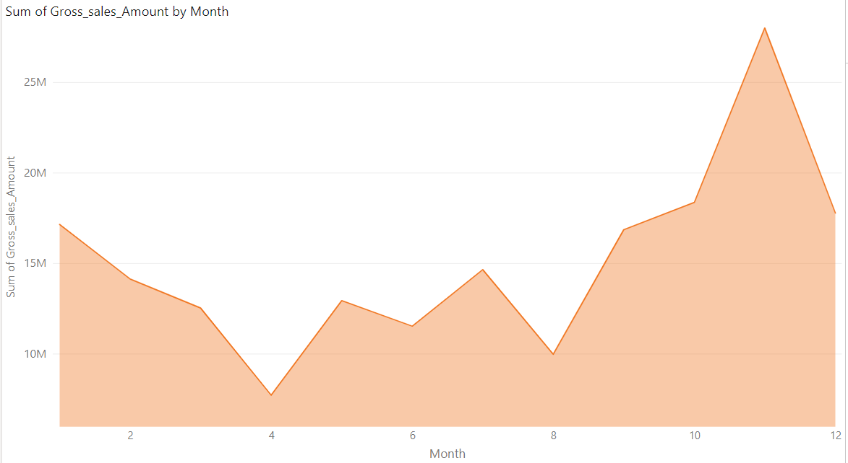
Conversion of output to visual
Insights
November has the highest gross sales followed by December and October due to festive season at this time o the year.
Company must focus on increasing their marketing during these months to increase sales.

Slide 16
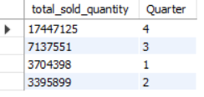
Sales Analysis by Quarter
Question 8
In which quarter of 2020, got the maximum total_sold_quantity? The final output contains these fields sorted by the total_sold_quantity,
Quarter
total_sold_quantity
Output:

Slide 17
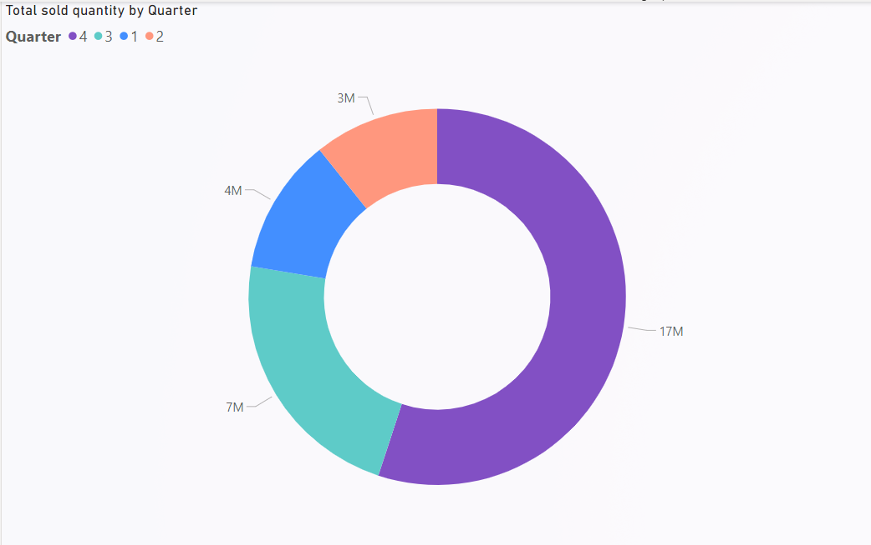
Conversion of output to visual
Insights
The 4th Quarter saw maximum sale of products followed by 3rd Quarter. Festive season and year end sale has led to the growth of product sales in Quarter 4.
“Atliq Hardwares” should focus on targeting more customers during this Quarter and spend more on marketing as compared to rest of the year during 4th quarter.

Slide 18
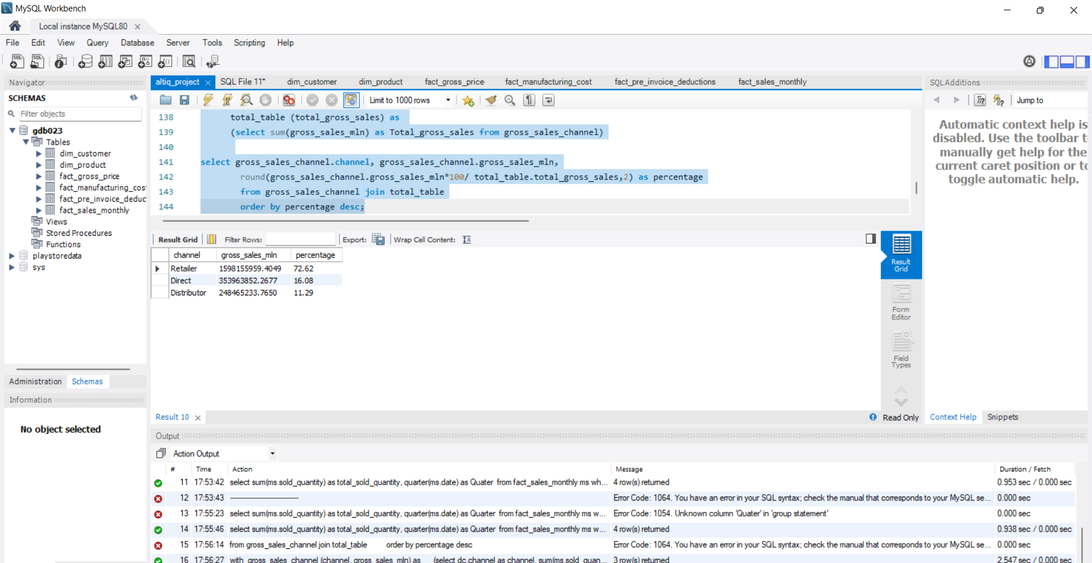
Gross Sales analysis by channel
Question 9
Which channel helped to bring more gross sales in the fiscal year 2021 and the percentage of contribution? The final output contains these fields,
channel
gross_sales_mln
percentage
Output:

Slide 19
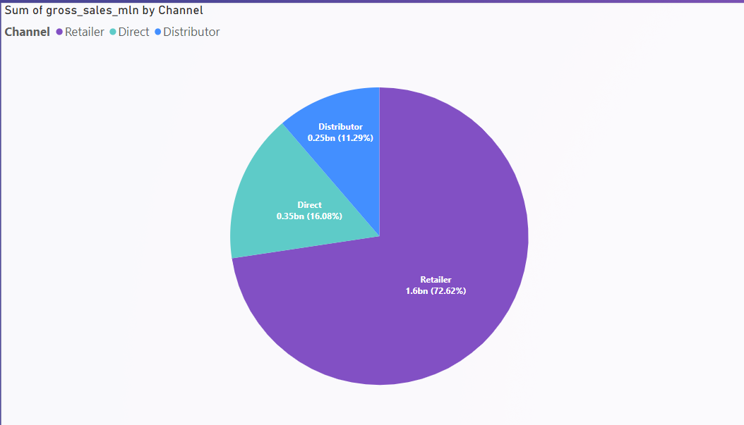
Conversion of output to visual
Insights
The Retailer channel was responsible for the 72% of total gross sales, followed by Direct(16%) and Distributor(11%).
“Atliq Hardwares” should focus on increasing their sales through Direct and Distributor Channel to increase the total Gross sales and further Total Profit.

Slide 20
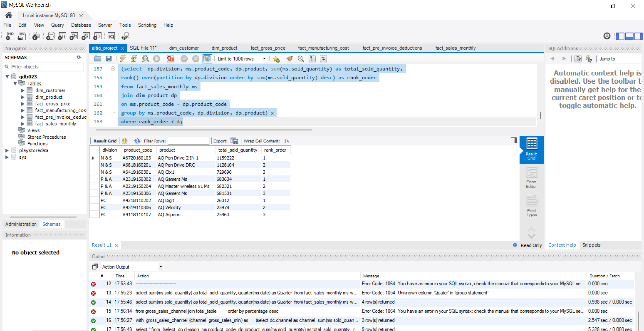
Top selling Products form each division
Question 10
Get the Top 3 products in each division that have a high total_sold_quantity in the fiscal_year 2021? The final output contains these fields,
division
product_code
product
total_sold_quantity
rank_order
Output:

Slide 21
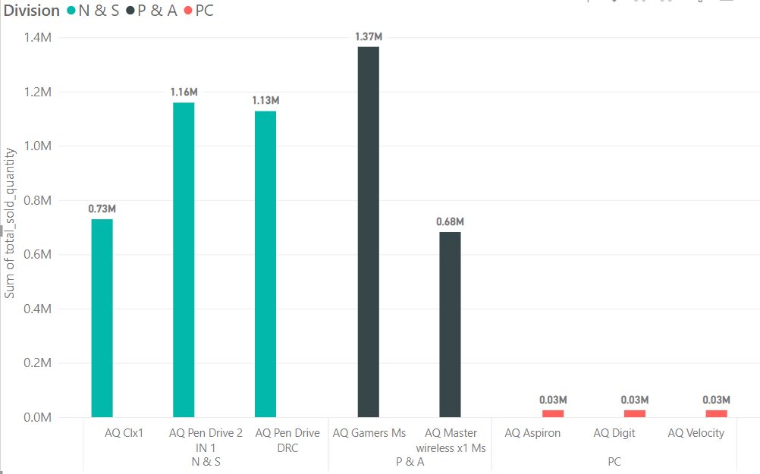
Conversion of output to visual
Insights
“AQ pen drive 2 IN 1” had the highest sales in the N&S division. “AQ Gamers Ms” had the highest sales in the P&A division, “AQ Digit” had the highest sales in the PC division.
“Atliq Hardwares” should focus on their PC division, It is lagging form the other 2 divisions.

Slide 22
Thank You

